Slide 1
Review
The letters of the word BALDIVIS are written onto 8
Cards, put in a hat, and one is chosen at random:
i) State the Sample Space
ii) Find Pr(the letter V is chosen)
iii) Find the Pr(a vowel is chosen)
Now think about:
What is the Probability that a V is NOT chosen?
What is the Probability that a vowel is NOT chosen?
Notes:
hook

Slide 2
Lesson objective
By the end of this lesson you will be able to define what the complement of an event occurring is, give examples on how it is used in real-life and apply it to solve more complex probability problems
Notes:
Lesson

Slide 3

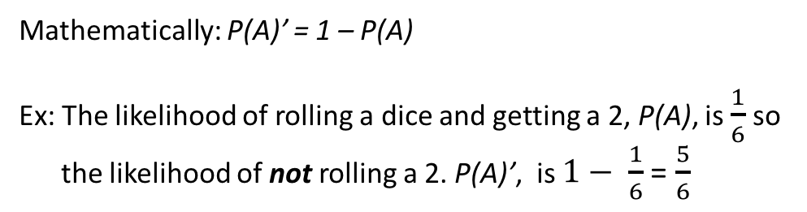
24
7
30
Date
Probability - Complement
EQ – How can learning about the complement of an event expand our knowledge of probability
What is complement?
If Probability is defined as the chance of an event, P(A), happening, then Complement, shown as P(not A) or P(A)’, is the chance that an event doesn’t happen.
Remember, the likelihood of an event happening can be shown
on a scale of like this:
Mathematically: P(A)’ = 1 – P(A)
Ex: The likelihood of rolling a dice and getting a 2, P(A), is $\frac{1}{6}$ so
the likelihood of not rolling a 2. P(A)’, is $1− \frac{1}{6}$ = $\frac{5}{6}$
Notes:
Lesson objective (EQ)

Slide 4
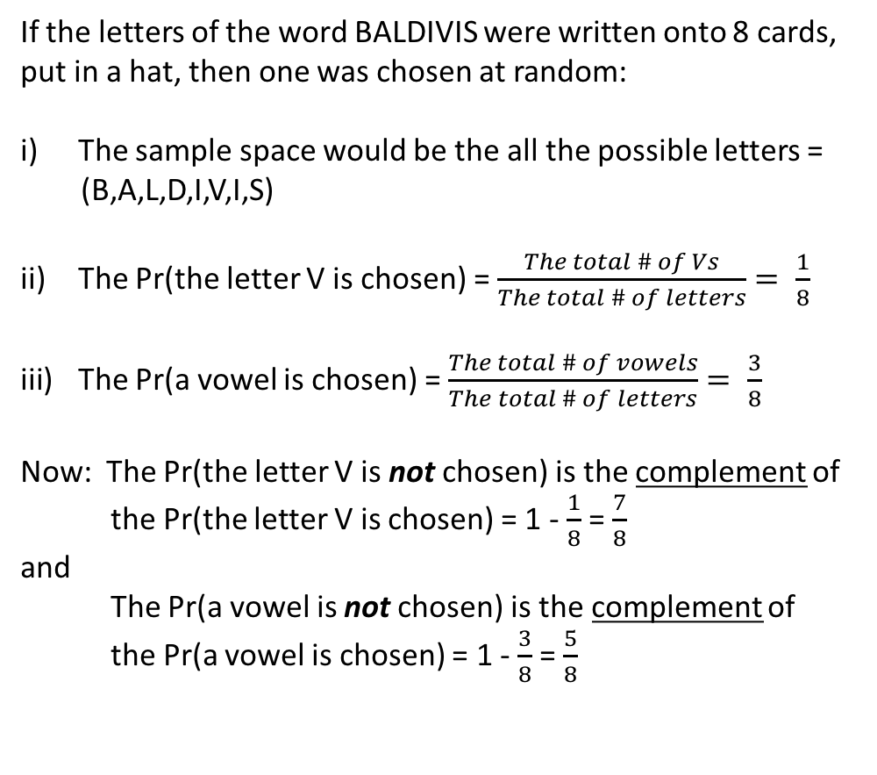
24
7
30
Date
Probability - Complement
EQ – How can learning about the complement of an event expand our knowledge of probability
From our Review Example
If the letters of the word BALDIVIS were written onto 8 cards,
put in a hat, then one was chosen at random:
The sample space would be the all the possible letters =
(B,A,L,D,I,V,I,S)
The Pr(the letter V is chosen) = $\frac{The total \# of Vs}{The total \# of letters}= \frac{1}{8}$
The Pr(a vowel is chosen) = $\frac{The total \# of vowels}{The total \# of letters}= \frac{3}{8}$
Now: The Pr(the letter V is not chosen) is the complement of
the Pr(the letter V is chosen) = 1 - $\frac{1}{8}$ = $\frac{7}{8}$
and
The Pr(a vowel is not chosen) is the complement of
the Pr(a vowel is chosen) = 1 - $\frac{3}{8}$ = $\frac{5}{8}$
5
Notes:
Input

Slide 5
Your Turn
Write the complement of each of the following:
a) The ball is red.
b) An even will show.
c) William will fall ill.
2. Ten Balls are numbered 1 to 10.
What is the probability of selecting a ball that shows:
a) A multiple of 3?
b) not a multiple of 3?
3. What are some real-life examples of the complement
of an event being talked about?
Notes:
Check for understanding

Slide 6
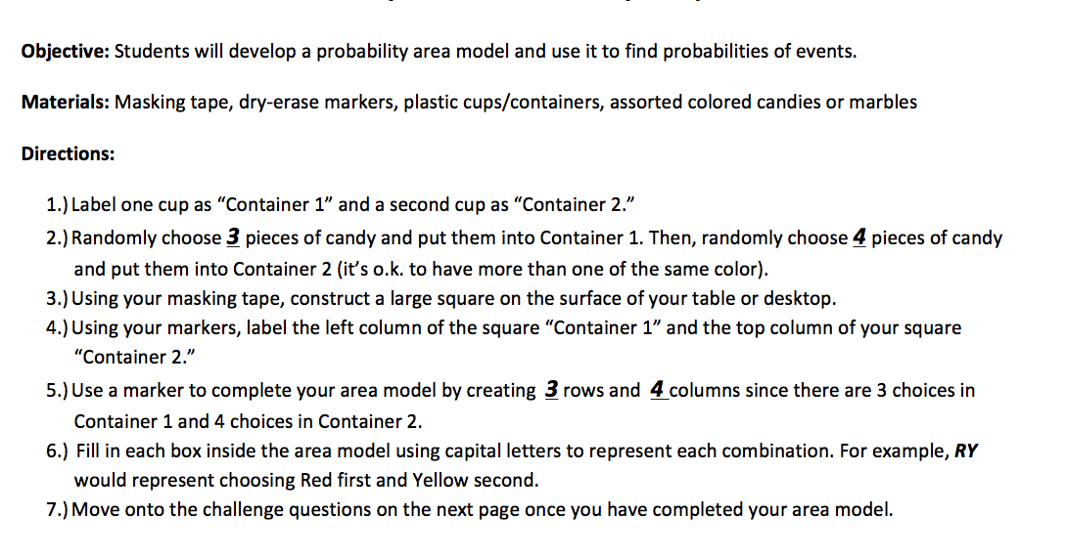
Probability Game
https://www.youtube.com/watch?v=tyAwxrUadtw&t=305s

Slide 7
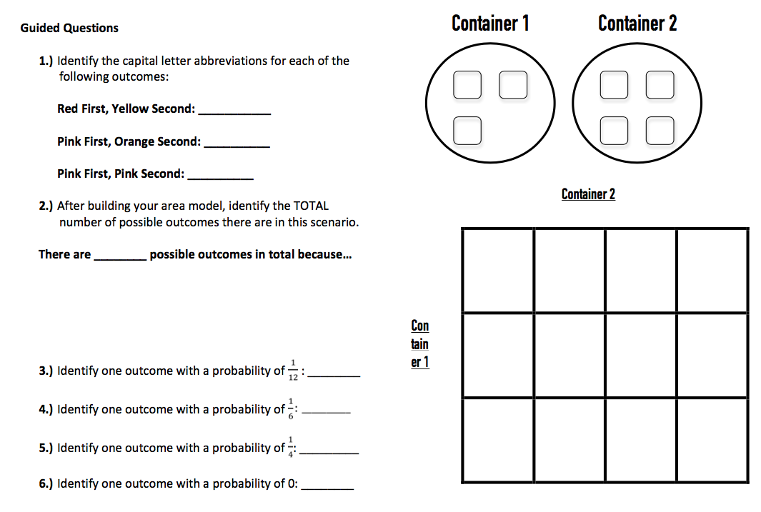

Slide 8
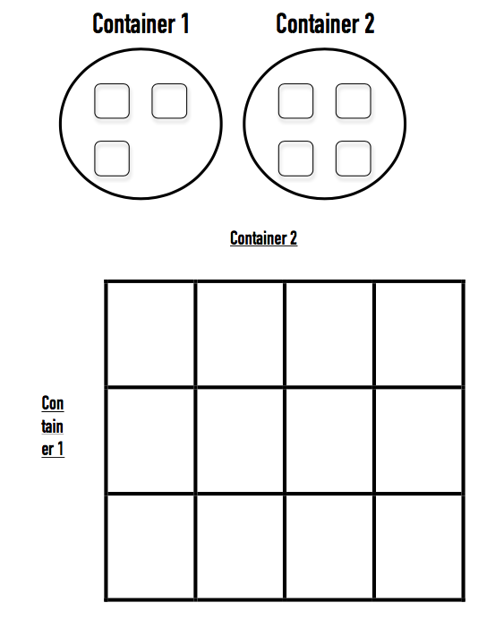
9) What is the complement to the
event of picking two reds?
10) What is the complement to the
event of picking only one pink?
11) What is the complement to the
event of picking zero oranges?

Slide 9
Exit Slip
Define the complement of an event and give one real-life example of the probability of an event happening, and it’s complement. Use your imagination!

